Slide 1
Data Visualization of Bird Strikes between 2000 – 2011

Slide 2
Objective:
Build a dashboard for Visualization of Bird Strikes between 2000 – 2011 in US.
Benefits:
Gives better insight into Bird Strikes Data Visualization.
Help in easy understanding of the data.

Slide 3
Data Sharing Agreement:
Sample File Name: Bird Strikes_Final.xlsx
Number of Columns: 25559
Number of Rows: 26
Column Names:1)Record ID 2)Aircraft: Type 3)Airport: Name 4)Altitude bin 5)Aircraft: Make/Model 6)Wildlife: Number struck 7)Wildlife: Number Struck Actual 8)Effect: Impact to flight 9)FlightDate 10)Effect: Indicated Damage 11)Aircraft: Number of engines? 12)Aircraft: Airline/Operator 13)Origin State 14)When: Phase of flight 15)Conditions: Precipitation 16)Remains of wildlife collected? 17)Remains of wildlife sent to Smithsonian 18)Remarks19)Wildlife: Size 20)Conditions: Sky 21)Wildlife: Species 22)Pilot warned of birds or wildlife? 23)Cost: Total $ 24)Feet above ground 25)Number of people injured 26)Is Aircraft Large?

Slide 4
Architecture :
START
GET DATA
DATA VALIDATION
DATA TRANSFORMATION
END
DATA VISUALIZATION
DATA INSERTION INTO POWER BI

Slide 5
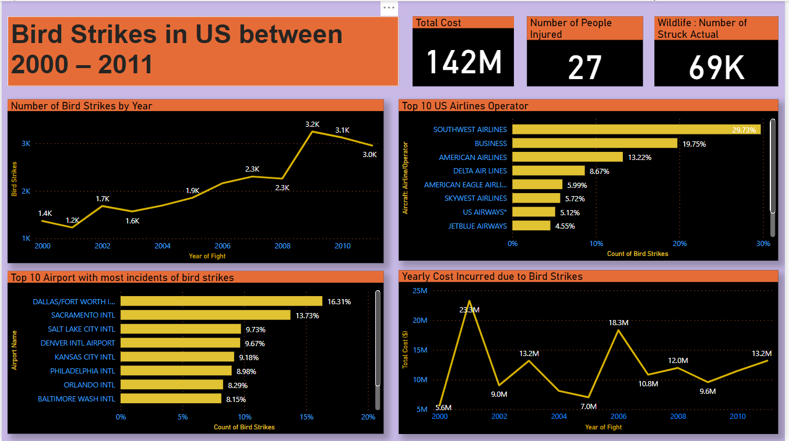
Result 1/2 :

Slide 6
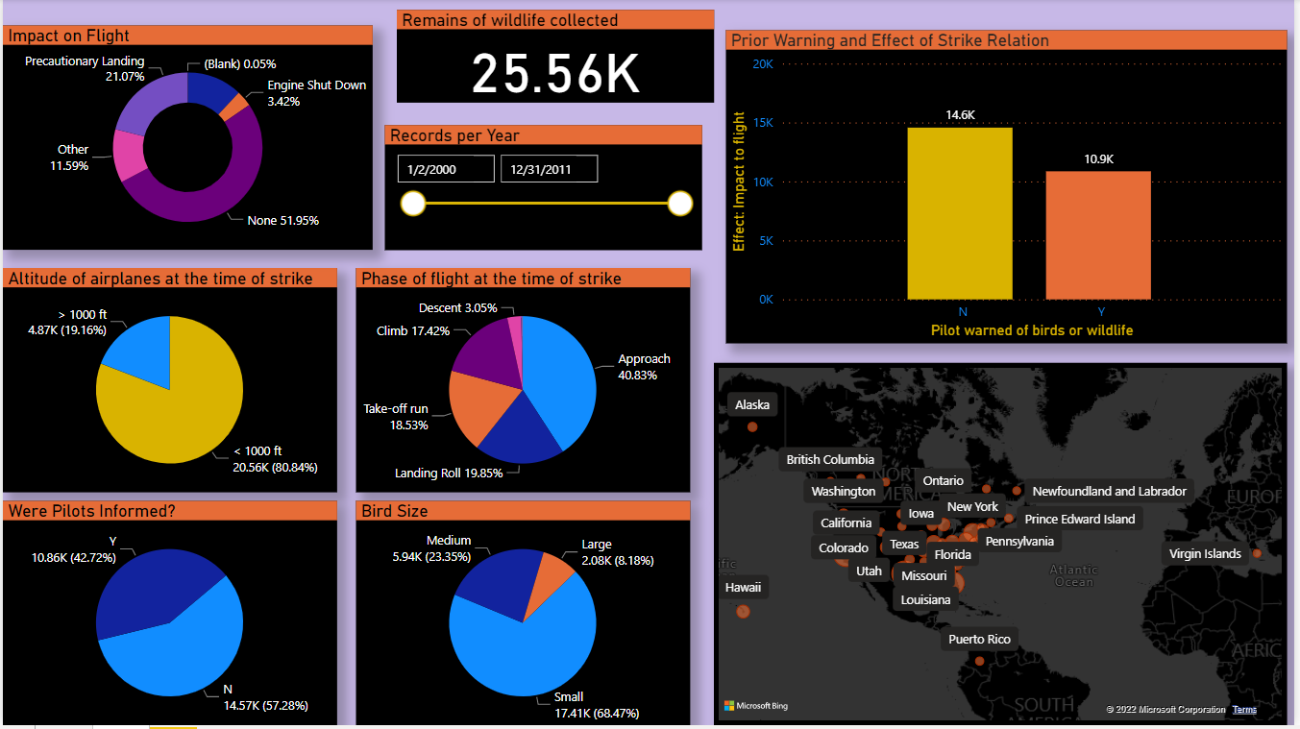
Result 2/2 :

Slide 7
Q & A:
Q1) What’s the source of data?
→ The data is provided by the ineuron.ai in (.xlsx) format.
Q2) What was the type of data?
The data was the combination of numerical and Categorical values.
Q3) What’s the complete flow you followed in this Project?
Refer slide 4th for better Understanding.
Q4) What are the different stages of deployment?
→ When the dashboard was ready I downloaded it inside my local system and then uploaded it on GitHub.

Slide 8
Q5) What techniques were you using for data pre-processing?
Removing unwanted attributes
Visualizing relation of independent variables with each other and output variables
Checking and changing Distribution of continuous values
Removing outliers
Cleaning data and imputing if null values are present.
Converting categorical data into numeric values.
Scaling the data

